Slide 1

Analysing Amazon Sales data

Slide 2
Introduction
In today’s data-driven market, understanding sales performance is crucial for strategic decision-making. This presentation showcases a comprehensive analysis of Amazon sales data using PowerBI. By visualizing key metrics and trends, we gain valuable insights into sales performance, customer behavior, and market dynamics. The dashboard provides a detailed overview of sales patterns, enabling data-driven strategies to enhance business outcomes.

Slide 3
Data Overview
The dataset used for this analysis consists of Amazon sales transactions over a specified period. It includes several key data points:
Transaction Date: The date when the transaction occurred.
Product Categories: Classification of items sold, such as electronics, clothing, and home goods.
Sales Revenue: The total revenue generated from each sale.
Units Sold: The number of units sold per transaction.
Customer Demographics: Information such as customer age, location, and purchasing behavior.

Slide 4
Main KPIs
Sales-trend -> month-wise,
Sales-trend -> year-wise,
Sales-trend-> yearly_month-wise
Total Revenue
Total Profit

Slide 5
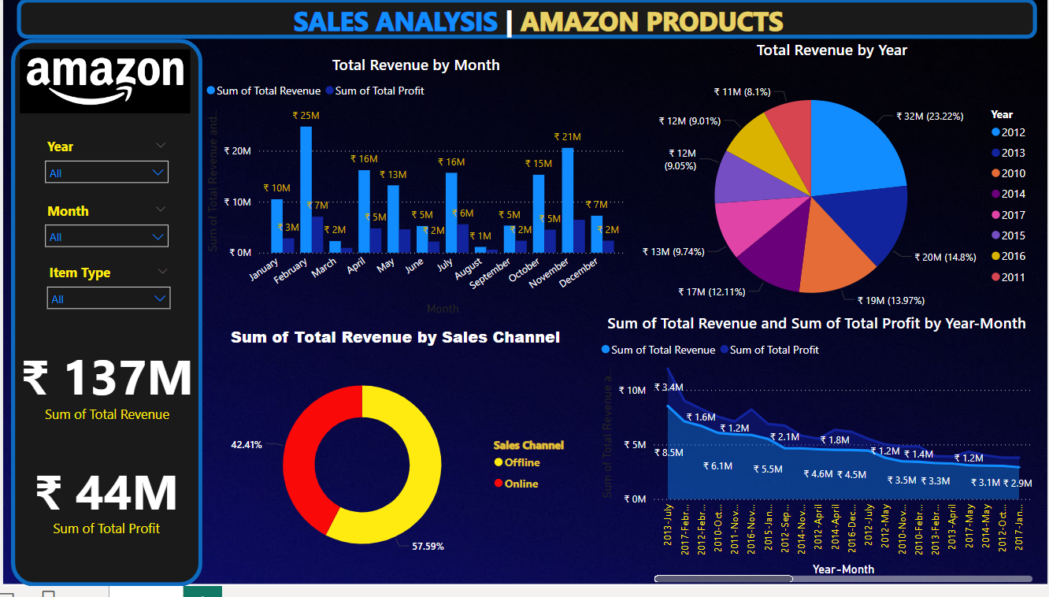
Dashboard

Slide 6
Thank You
Name – Kartik
UNID – UMIP15423
Batch – 04-07-2024 to 05-08-2024

